Slide 1
Authenticate and connect with Microsoft Graph
Authentication overview

Slide 2

Authentication overview
OAuth basics
Endpoint versions
Key improvements in v2.0 endpoint
JWT tokens
Types of flows
Obtain a token and connect with Microsoft Graph

Slide 3



OAuth basics
OAuth client (native or web app)
Resource Server (REST API)
Access data
Bearer token
Access service
Delegate AuthN/AuthZ
Issue token
Grant access
Resource owner (end user)
Authorization server
Notes:
Every scenario has these basic parts. There are various implementations, but the premise is the same for all.
Both the client and the resource server need to know about the authorization server, in this case Azure AD.

Slide 4

Endpoint versions
v1
Microsoft account
Azure Active Directory v2.0 endpoint
Converged authentication accepts sign in from both Microsoft personal accounts and Azure AD work and school accounts.
Enables the same code for using Microsoft Graph for things like reading mail or retrieving contacts.
Dynamic consent, requesting permissions when you need them.
Additional Microsoft Graph capabilities for AAD users such as SharePoint and Microsoft Teams.
Azure Active Directory v1 endpoint
Enables access to Azure protected resources
v2
v1
Azure Active Directory
http://aka.ms/aadv2
AD
AD
AD
Notes:
The v2 endpoint includes breaking changes to protocols.
This is why it is the V2 endpoint. Because the protocol is different, requires new client library implementations.

Slide 5
Key improvements v2.0 versus v1
scope instead of resource parameter for interop
v1: resource=https://graph.microsoft.com
v2: scope=https://graph.microsoft.com/User.Read
Dynamic instead of static consent for incremental consent
id_token claims updated to OpenID Connect standard
Single app registration to represent native and web application combination
Well-known scopes
offline_access – Enables retrieving refresh tokens
openid – Allows your app to sign the user in and receive an app-specific identifier for the user
email – Allows your app access to the user’s primary email address via the email claim in the token
profile – Allows your app access to all other basic information such as name, preferred username, object ID, and others.
https://docs.microsoft.com/en-us/azure/active-directory/develop/active-directory-v2-compare
Notes:
In v1 endpoint, had to provide resource parameter to identify which resource you were requesting an access token for. Open source libraries were not able to easily incorporate into requests. Now use the scope parameter, which is supported by all libraries, to compound the resource and permission.
When you build applications with AADv1, had to register what permissions the application needed, and user consented to all permissions statically. With AADv2, can now send scopes you want at the time you want them, don’t need to ask for all of it up front.
Changed contents of id_token to better conform to Open ID Connect 1.0 specification, such as using preferredUserName claim instead of UPN claim. The most
In the past, if you needed a client app, single page app, web app, and web API, you had to create multiple registrations and wire up the relationships between them. AAD v2 now enables one registration across a single logical application.
For more information: https://docs.microsoft.com/en-us/azure/active-directory/develop/active-directory-v2-compare

Slide 6
V2.0 Endpoints
https://login.microsoftonline.com/{tenant}/oauth2/v2.0/authorize
https://login.microsoftonline.com/{tenant}/oauth2/v2.0/token
Value | Description
common | Allows users with both personal Microsoft accounts and work/school accounts from Azure Active Directory to sign into the application.
organizations | Allows only users with work/school accounts from Azure Active Directory to sign into the application.
consumers | Allows only users with personal Microsoft accounts (MSA) to sign into the application.
8eaef023-2b34-4da1-9baa-8bc8c9d6a490 or contoso.onmicrosoft.com | Allows only users with work/school accounts from a particular Azure Active Directory tenant to sign into the application.
Notes:
There are two primary endpoints for v2.0: /authorize and /token. Each of these can be scoped based on the {tenant} section of the URL.
Either the friendly domain name of the Azure AD tenant or the tenant's guid identifier can be used.

Slide 7
Authorize endpoint
https://login.microsoftonline.com/{tenant}/oauth2/v2.0/authorize?
client_id=6731de76-14a6-49ae-97bc-6eba6914391e
&response_type=code
&redirect_uri=http%3A%2F%2Flocalhost%2Fmyapp%2F
&response_mode=query
&scope=offline_access%20user.read%20mail.read &
state=12345
Parameter | Description
client_id | Your app’s application ID
response_type | “code” for authorization code flow
redirect_uri | Must match exactly one redirect URI registered for your app
response_mode | “query” or “form_post”
scope | Space-separated list of permissions, may also include OpenID scopes
state | Value sent in request will be included in response
Click here to try it!
Notes:
https://developer.microsoft.com/en-us/graph/docs/concepts/auth_v2_user
The response_mode indicates if the data should be returned in the querystring or if it is POSTed back. The demo uses a querystring to easily capture the return data.
State parameter can be anything you wish, data in equals data out. Using a randomly generated value for the state parameter with helps prevent against CSRF attacks (see https://tools.ietf.org/html/rfc6749#section-10.12).
The “Click here to try it” link is an app that will be redirected to http://localhost/myapp with a code. Can use this to demonstrate the converged endpoint experience: can log in with organizational accounts (work or school) or personal accounts (Microsoft Account).
For more information, see: https://developer.microsoft.com/en-us/graph/docs/concepts/auth_v2_user

Slide 8

SDKs
Microsoft Authentication Library (MSAL)
Targets v2.0 endpoint
New conceptual model
PublicClientApplication
ConfidentialClientApplication
Multiple platforms
MSAL.NET - .NET Client, Windows Store, UWP, Xamarin, iOS, and Android
MSAL.js – JavaScript
MSAL for ObjectiveC – iOS and macOS
MSAL for Android – Android
Azure Active Directory Authentication Library (ADAL)
Targets v1 endpoint
Notes:
As there are changes in the protocols between v1 and v2, this requires a change in the SDK and a new conceptual model.
PublicClientApplication uses the registered application ID. ConfidentialClientApplication has a secret (clientSecret or x.509 certificate).
MSAL is considered the successor to ADAL. This course focuses on MSAL and the AAD v2 endpoint with Microsoft Graph.

Slide 9
JWT token
xxxxxx.yyyyyyyyyyyyyy.zzzzzzzzzz
Header
Payload
Signature
Section | Description
Header | Contains type of token (JWT) and the algorithm (RS256). Section is base64 URL encoded.
Payload | Contains claims such as: aud: Audience, identifies the resource the token is used for iss: Issuer, contains the ID of your Azure AD tenant nbf: Not before, Unix epoch time when the token is valid from exp: Expires, Unix epoch time when the token expires appid: Your app’s Application ID Section is base64 URL encoded.
Signature | Combines the encoded header and encoded payload, uses algorithm from header to sign using a secret.
Notes:
The JWT token format is 3 strings separated by periods: header, payload, and signature.
aud: "https://graph.microsoft.com",
iss: "https://sts.windows.net/e2881ae0-1790-4387-b49a-a4231b4c295d/",
iat: 1503926773,
nbf: 1503926773,
exp: 1503929373,
The JWT token can be decoded, so it is required to secure apps using HTTPS. The token can be decoded using a tool such as http://jwt.calebb.net.
It’s worth noting that tokens are not encrypted by AzureAD today, but could be in the future, in which case you would not be able to decrypt them.
For more information on JWT token formats, see

Slide 10

Types of tokens
ID tokens
Used with OpenID Connect
Contains claims you can use to sign the user into your app
Access tokens
Currently can only be consumed by Microsoft Services
v2.0 endpoint returns metadata including expiry and scopes
Refresh tokens
Used to request a new access token, providing long-term access to resources
Multi-resource
https://docs.microsoft.com/en-us/azure/active-directory/develop/active-directory-v2-tokens
Notes:
All tokens are JWT tokens.
Format and content of ID tokens are consistent for personal MSA accounts as well as work or school accounts.
Access token requests include metadata such as expiry and scopes, avoiding the need to parse the JWT token.
Refresh tokens are multi-resource. A refresh token received during a token request for one resource can be redeemed for access tokens to a completely different resource.
For more information, see https://docs.microsoft.com/en-us/azure/active-directory/develop/active-directory-v2-tokens

Slide 11

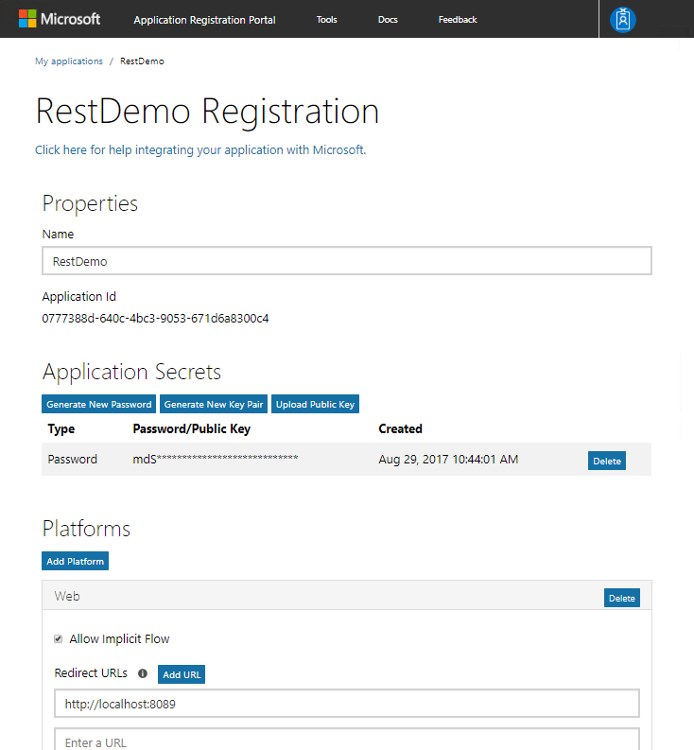
Register your application
Notes:
Registering the application generates the Application ID. Creating an application secret is required because it is a web URL (in GraphClient SDK, this is considered a ConfidentialClientApplication, one that contains a secret). The client secret is required here because it is calling back to a web URL, it would not be required if using a native application.

Slide 12
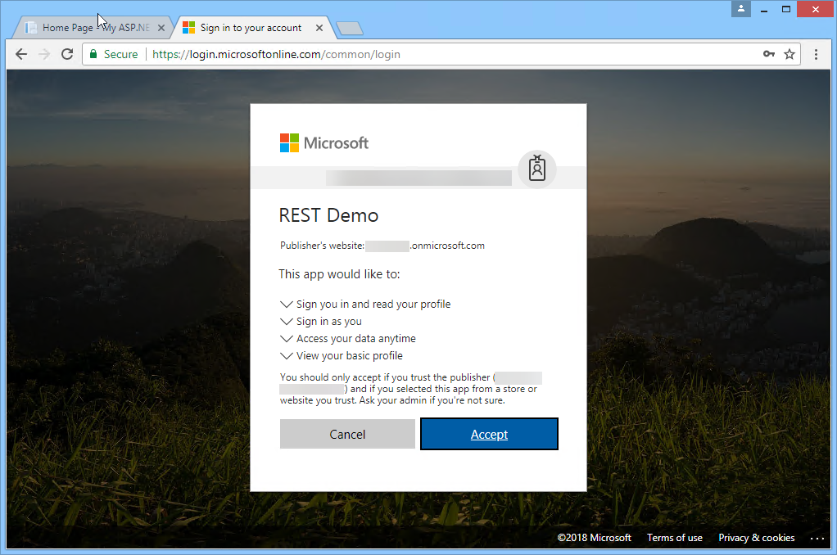
Get authorization
Request
GET
https://login.microsoftonline.com/common/oauth2/v2.0/authorize?
scope=offline_access+openid+profile+User.Read
&response_type=code
&client_id=0777388d-640c-4bc3-9053-671d6a8300c4
&redirect_uri=https://localhost:8089
&response_mode=query
Response
GET
https://localhost:8089/?code=OAQABAAPSY4jIAA
Notes:
The authorize endpoint will prompt the user to sign in and to grant consent to the requested permissions. The response will be directed back to the configured redirect URL.
A common configuration mistake is when the redirect URL doesn’t exactly match one of the redirect URLs configured for the application, including if there is a trailing slash or not.

Slide 13
Get a token
Request
POST https://login.microsoftonline.com/common/oauth2/v2.0/token HTTP/1.1
Content-Type: application/x-www-form-urlencoded
client_id=50d65aa4-adbb-45c5-b473-0459bac3110e&client_secret=seeecret
&scope=offline_access+openid+profile+User.Read&grant_type=authorization_code
&code=OAQABAAPSY4jIAA&redirect_uri=https://localhost:8089
Response
HTTP/1.1 200 OK
Cache-Control: no-cache, no-store
Pragma: no-cache
Content-Type: application/json; charset=utf-8
Content-Length: 3716
{"token_type":"Bearer","scope":"User.Read","expires_in":3599,"ext_expires_in":0,"access_token":"eyJ0eXAiOiJKV1QiLC","refresh_token":"OAQABAAAAAAA9k","id_token":"eyJ0eXAiOiAbC1Qi123”}
Notes:
The HTTP request to the token endpoint POSTs the body content. The result is an HTTP 200 OK that contains the access token.
The refresh token is returned when the scope includes the “offline_access” permission.
The id token is returned when the “openid” permission is requested.
Some data such as HTTP headers has been omitted for brevity.

Slide 14
Use the access token to call Microsoft Graph
Request
GET https://graph.microsoft.com/v1.0/me HTTP/1.1
Authorization: bearer eyJ0eXAiOiJKV1QiLC
Host: graph.microsoft.com
Response
HTTP/1.1 200 OK
Content-Type: application/json;odata.metadata=minimal;odata.streaming=true;IEEE754Compatible=false;charset=utf-8
{"@odata.context":"https://graph.microsoft.com/v1.0/$metadata#users/$entity","id":"0777388d-640c-4bc3-9053-671d6a8300c4","businessPhones":["+1 888 555 1212"],"displayName":"Adele Vance","givenName":"Adele","jobTitle":"Product Marketing Manager", "mail":"AdeleV@msgraphdemo.onmicrosoft.com", "mobilePhone":null,"officeLocation":“Chicago", "preferredLanguage":"en-US","surname":"Vance","userPrincipalName":"AdeleV@msgraphdemo.onmicrosoft.com"}
Notes:
The access token is used as the value for the Authorization header in the GET request to the Microsoft Graph.
Some data such as HTTP headers has been omitted for brevity.

Slide 15
Demo

Slide 16

Summary
New endpoint for AAD provides converged authentication for personal accounts as well as work or school accounts
New MSAL libraries simplify applications that have multiple platform components

Slide 17
Thank you

